Slide 1
Large-Scale and Multi-Structured Databases Project Design My Vacation
Lorenzo Bataloni
Claudio Daka
Edoardo Pantè

Slide 2
Application Highlights
The My Vacation application is designed to book accomodations and activities
The main features of the application are:
Users can post an advertisement (accommodation or activity)
Users can book an accommodation or an activity

Slide 3
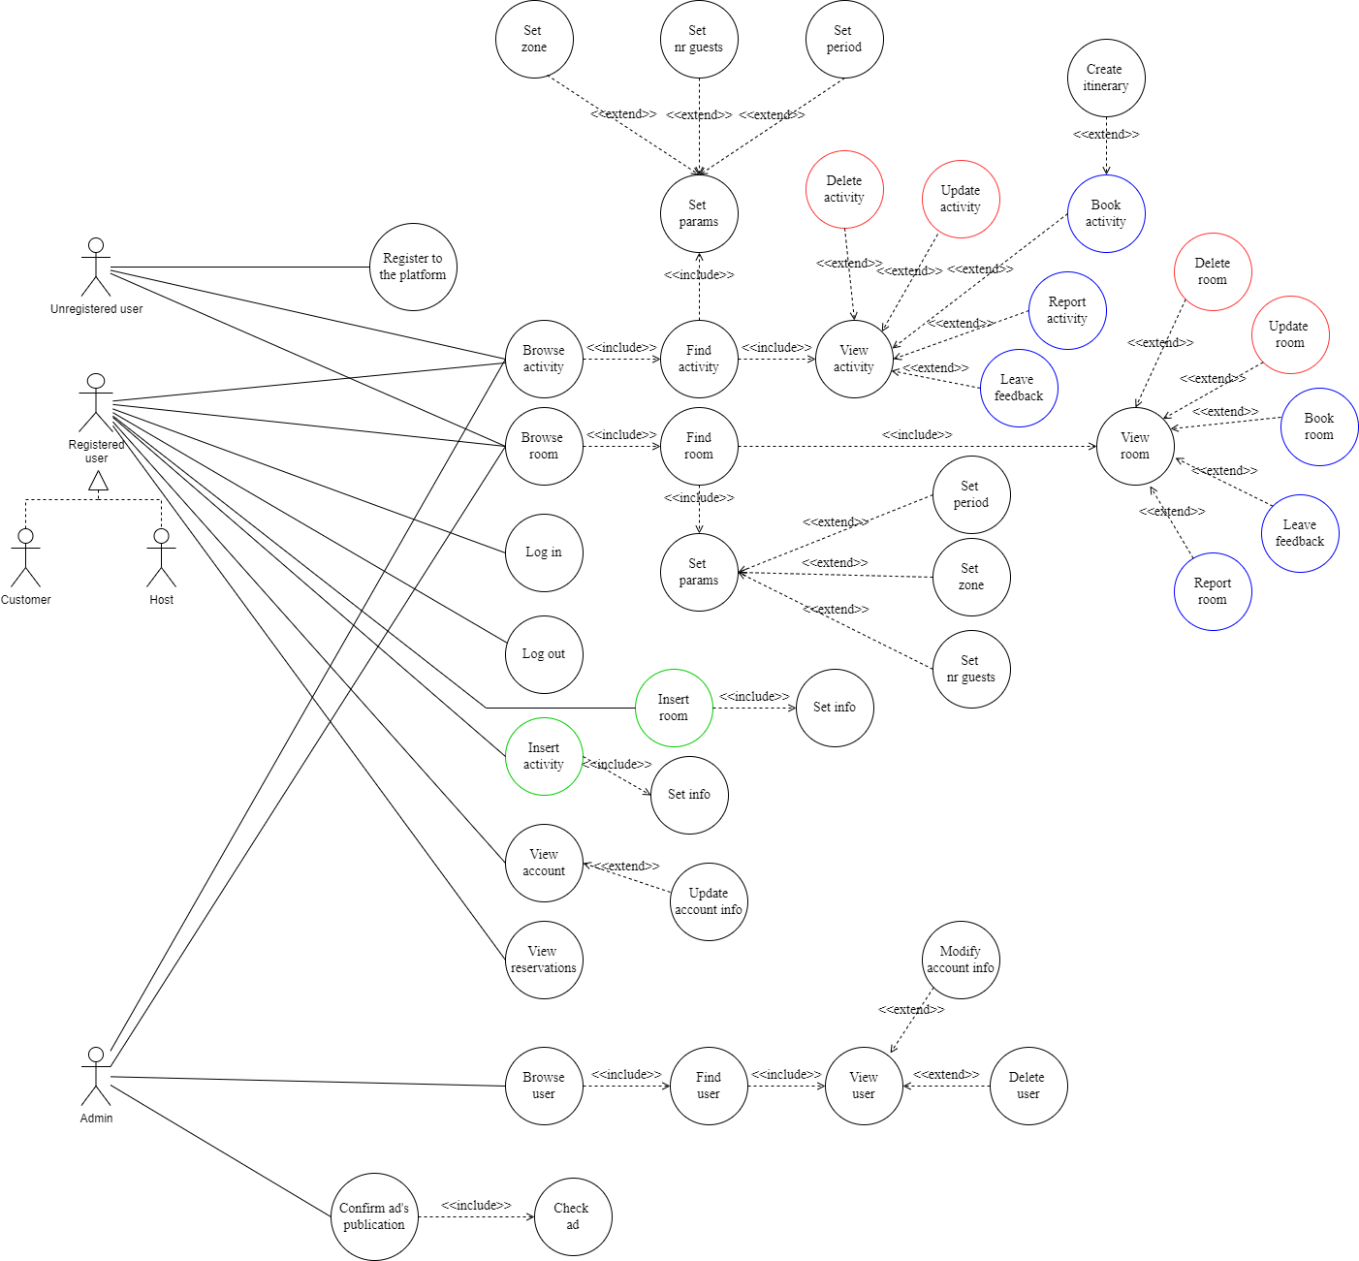
Actors and main supported functionalities

Slide 4
Dataset Description
Source:
Description:
Volume:
Variety:
Velocity/Variability:

Slide 5
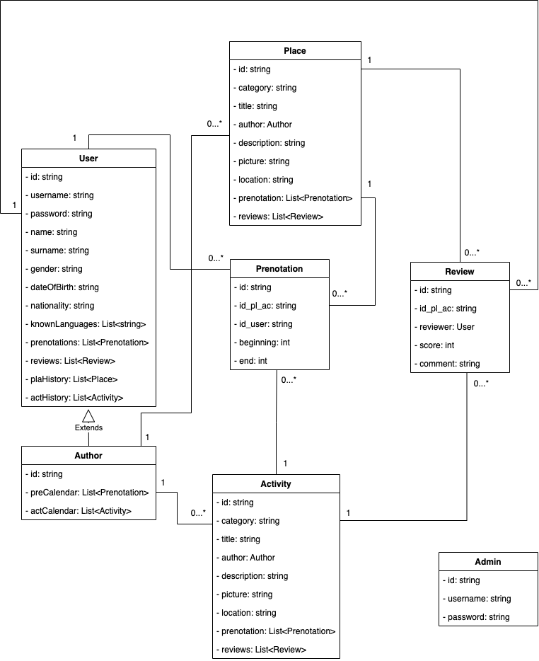
Preliminary UML Class Diagram

Slide 6
Requirements and Entities handled by Document DB

Slide 7
Requirements and Entities handled by Key-Value DB

Slide 8
Requirements and Entities handled by Graph DB

Slide 9
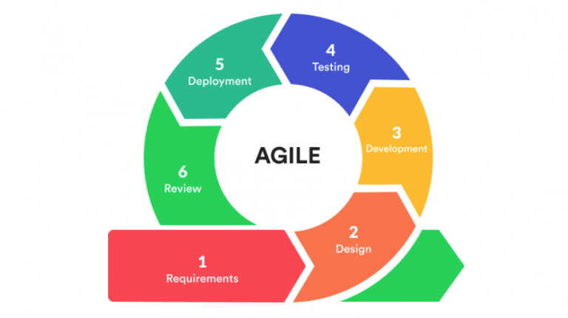
Software Architecture Preliminary Idea
Programming Languages:
Python
JavaScript
Frameworks:
Flask
Node.js
ReactJS
DMBSs:
MongoDB

